Slide 1

Bar Plot
Represents data in rectangular bars with length of the bar proportional to the value of the variable
Syntax: barplot(H, xlab, ylab, main, names.arg, col)
H - a vector or matrix containing numeric values
xlab - label for x axis.
ylab - label for y axis.
main - title of the bar chart
names.arg - is a vector of names appearing under each bar
col - to give colors to the bars in the graph
1

Slide 2
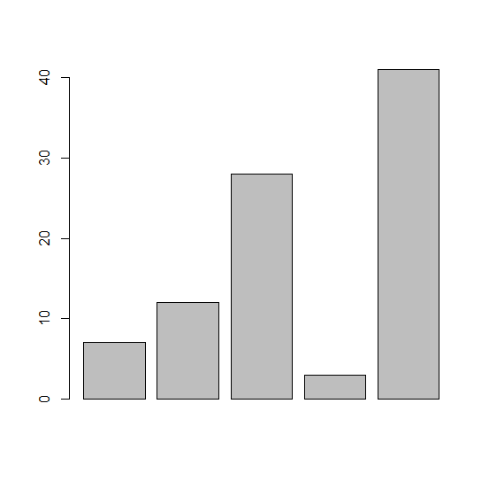
Bar Plot: Example
# Create the data for the chart.
> H <- c(7,12,28,3,41)
# Plot the bar chart.
> barplot(H)

Slide 3
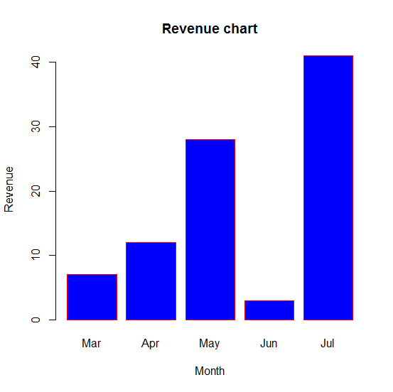
Bar Plot: Example
# LABELS, TITLE AND COLORS
# Create the data for the chart.
H <- c(7,12,28,3,41)
M <- c("Mar","Apr","May","Jun","Jul")
# Plot the bar chart.
barplot(H,names.arg = M,xlab = "Month",ylab = "Revenue",col = "blue",
main = "Revenue chart",border = "red")

Slide 4
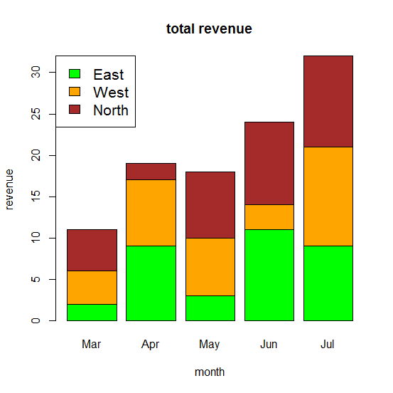
Group Bar Chart and Stacked Bar Chart: Example
# Create the input vectors.
> colors <- c("green","orange","brown")
> months <- c("Mar","Apr","May","Jun","Jul")
> regions <- c("East","West","North")
# Create the matrix of the values.
> Values <- matrix(c(2,9,3,11,9,4,8,7,3,12,5,2,8,10,11),nrow = 3,ncol = 5,byrow = TRUE)
# Create the bar chart.
> barplot(Values,main = "total revenue",names.arg = months,xlab = "month",ylab = "revenue", col = colors)
# Add the legend to the chart.
legend("topleft", regions, cex = 1.3, fill = colors)

